Slide 1
CQRS
Виконав
студент ПМІ-52
Іваськевич Юрій

Slide 2
Agenda
Classic approach and its issues
CQS
CQRS
Architecture
Benefits
Issues

Slide 3
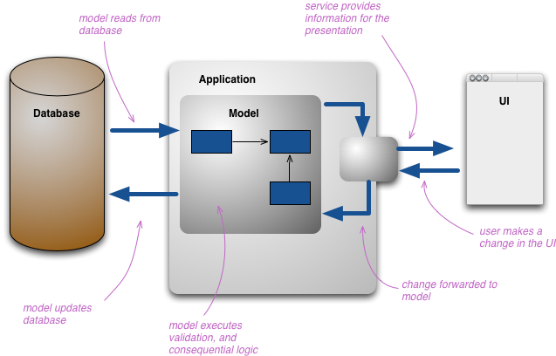
Classic approach

Slide 4
Issues of classic approach
Is suitable for simple CRUD-like applications
Hard to scale

Slide 5
CQS
Command Query Separation
Commands change state
Queries return data. Do not change state

Slide 6

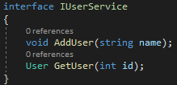
CQS

Slide 7
CQRS
Command Query Responsibility Segregation
Uses and extends CQS
One model splits into two
Enables a variety of architectural possibilities

Slide 8
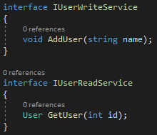
CQRS

Slide 9
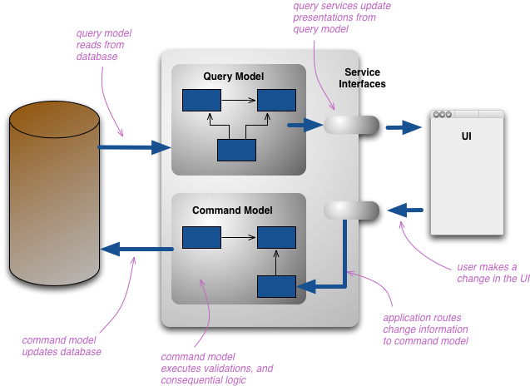
CQRS

Slide 10
Architecture possibilities
Separate read and write stores and even services
Add events as a mean to notify about command changes
Use message bus to ensure deterministic delivery of events
Use Event Sourcing
Load balancing

Slide 11
Benefits
Independent scaling and availability
Optimized reads and simpler queries
Clear separation of concerns
Audit trail via Event Sourcing
Ability to have several teams work separately
Security

Slide 12
Issues
Complexity
Eventual consistency
Hard to evaluate at project start

Slide 13
Sources
https://www.martinfowler.com/bliki/CQRS.html
https://www.martinfowler.com/bliki/CommandQuerySeparation.html
http://codebetter.com/gregyoung/2010/02/16/cqrs-task-based-uis-event-sourcing-agh/
https://docs.microsoft.com/en-us/azure/architecture/patterns/cqrs
https://medium.com/eleven-labs/cqrs-pattern-c1d6f8517314
http://udidahan.com/2009/12/09/clarified-cqrs/

Slide 14
ДЯКУЮ ЗА УВАГУ

